Slide 1
Hudson County Division of Housing and Community Development
Homeless efforts

Slide 2
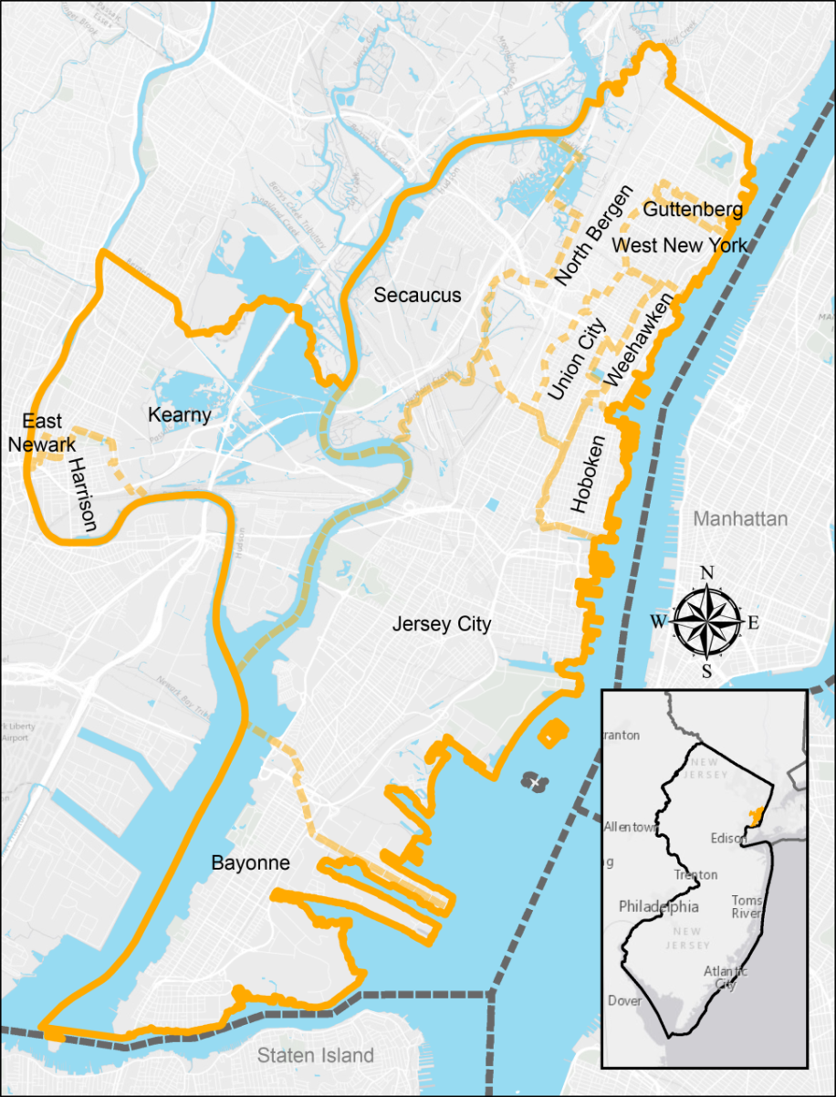
Hudson county
Estimated population: 675,000 in 12 municipalities
Geographically the smallest and most densely populated county in New Jersey
2016 Point-in-Time Count identified:
829 persons in 660 households (9.6% decrease)
137 Chronically homeless persons (21% decrease)
30 veterans (30% decrease)

Slide 3
Hudson county Division of Housing And Community Development
Receives and administers the following HUD programs:
$2 Million annually in Community Development Block Grant (CDBG)
$2 Million in HOME Investment Partnership Program
$165,000 in Emergency Solutions Grant (ESG) funding
Administers the Hudson County Homelessness Trust Fund
Collects an average of $150,000 annually
Collaborative Applicant/Lead Entity for Continuum of Care

Slide 4
Hudson County Continuum of Care
Organized as the Hudson County Alliance to End Homelessness
Formalized the process with the creation of bylaws in 2011
Diverse Executive Board
Active committees include, Veterans, Youth and Frequent Utilizers
Collaboration
Hudson County Division of Housing and Community Development and Jersey City Division of Community Development Serve as Co-chairs
Hudson County Health and Human Services, Office of Homeless Services, lead partner.
An average of 25 different nonprofits, stakeholders and government entities represented at monthly meetings

Slide 5
Hudson county continuum of care
Over $6 Million awarded to nonprofits in 2016
Reallocated over $2.8 Million from Transitional Housing, SSO projects and poor performing programs since 2012
Reallocated funds were used to create Coordinated Assessment, Rapid Rehousing and Permanent Supportive Housing projects
Successfully secured CoC Bonus Funds for new programs

Slide 6
Coordinated entry program
Goal: All individuals and families experiencing homeless will be assessed and directed to the most appropriate housing and services based on their individual needs
Fully implemented in 2015
Agency based model – Garden State Episcopal CDC
Two physical locations, street outreach and scattered site at shelters
Individuals/families prioritized for housing based on assessment score and HUD Notice CPD-16-11
All CoC and ESG funded RRH and PSH programs must only take referrals from CEP
Expanded to include others: HUD multifamily preference, HCHTF, HOME, CDBG and LIHTC Projects

Slide 7
Benefits of Coordinated entry
Simplifies the process for individuals and families experiencing homelessness
Allows housing providers to focus on providing housing and supportive services, not identifying new clients/tenants
Ensures households and individuals are referred to the most appropriate level of housing based on their need
Provides ongoing case management until housing is available

Slide 8
Coordinated entry results
1580 households were served through CEP in 2016
464 households exited/discharged from the program
62% or 288 went to a permanent housing location
Less than 2% returned to homelessness
Median length of stay for those permanently housed was approximately 5 months

Slide 9
Frequent Users Initiative
Homeless System
Jail
Hospital
Goal:
Identify and house those who are the most frequent utilizers of the Hudson County Jail, local hospitals and the Homeless System

Slide 10
Hudson County Department of Corrections and Rehabilitation
Operates a progressive Community Reintegration Program
Provides comprehensive services to individuals while incarcerated (Inpatient drug and mental health treatment, GED, vocational training etc.)
Community-Based Services after release (connection to benefits, FQHC, continued mental health and substance abuse, case management etc.)
Housing
Transitional- Maximum 15 months of sober/clean housing
Notes:
-Individuals with drug offenses are required to complete a 30 day drug treatment program prior to receiving welfare benefits.
Inpatient drug treatment became licensed in ___ allowing inmates to complete the treatment program in jail. First in state
-Passed legislation enabling the treatment to be licensed
Even our providers note that it is better for clients to be in the jail…
EA can pay backwards 90 days-
Served 60 months for distribution after 1996 lifetime ban on Welfare benefits- vetoed by governor last year, bill on Gov desk again.
Urban areas- in a school zone basically everywhere

Slide 11
Corrections and Housing Partnership
Limited collaboration prior to Frequent User Initiative
The Winter Warming Center served as a catalyst
Created as a result of community input and need for additional placements for unsheltered homeless during the cold winter months
Continuous, staffed by Department of Corrections first year
Averaged 75 persons a night
Analyzed usage of the WC and Incarcerations for 28 individuals:
2,096 nights in jail during the winter of 2013-14 (before WC)
334 nights in jail the winter of 2014-15 (during WC)
Helped initiate the conversation about permanent solutions
Identified a gap in housing and services

Slide 12
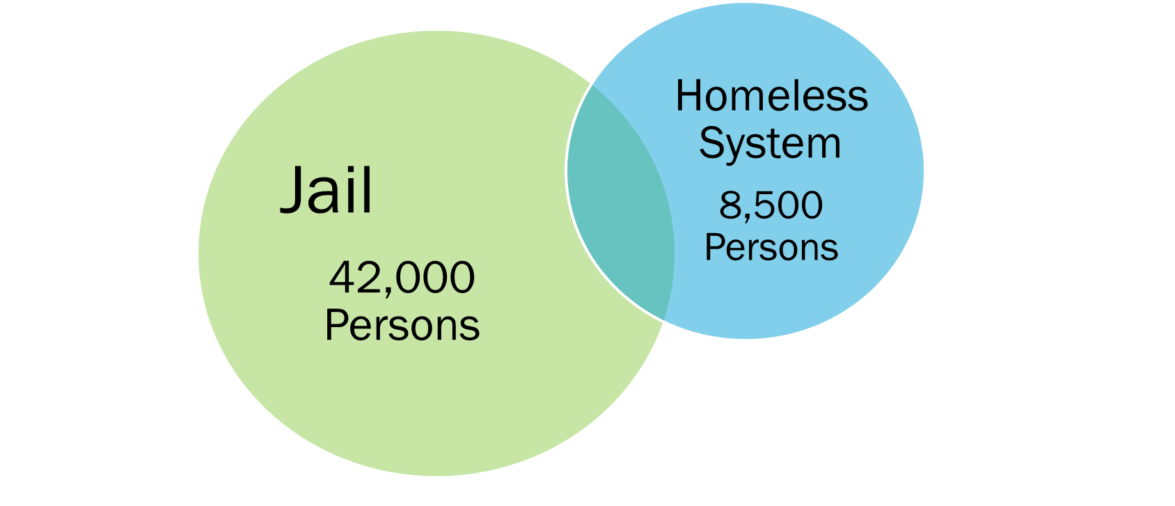
Actual data match
Analyzed 5 years of Jail and HMIS Data
Initial Jail data was provided by NJ Administrative Office of the Courts
HMIS Data is “owned” by CoC programs County historically only has aggregate level view
Continuum of Care voted to allow access to view names in order to perform match
Overlap=2000
5% of jail population has experienced homelessness
23% of Homeless population has been incarcerated

Slide 13
Permanent Supportive housing for Frequent Utilizers
CoC Bonus Project
27 Units of PSH targeted frequent utilizers of jail and/or hospitals.
Targeted those with highest vulnerability scores first
Currently assessing outcomes of those housed
DCA Housing First Initiative
100 vouchers were secured for frequent utilizers of jail
Hudson County providing service funding for the vouchers
Matching jail and HMIS data to target those with highest number of incarcerations first.

Slide 14
Contact Information
Hudson County Division of Housing and Community Development
201-369-4520
Randi Moore, Division Chief
rmoore@hcnj.us
Carol Sainthilaire, Program Director
csainthilaire @hcnj.us

